Slide 1
Conway’s game of life
Kozlov Kirill and Palkin Egor, group 22215
NSU, Computer science and System design
2023

Slide 2
Main points
1.
Main concept
and improvements
2.
Difficulties and solutions
3.
Demonstration

Slide 3
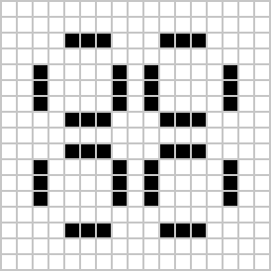
Main concept
The playing surface is infinite or limited field divided by cells.
Each cell can be alive or dead.
At each iteration the population of the field changes according to set rules.

Slide 4
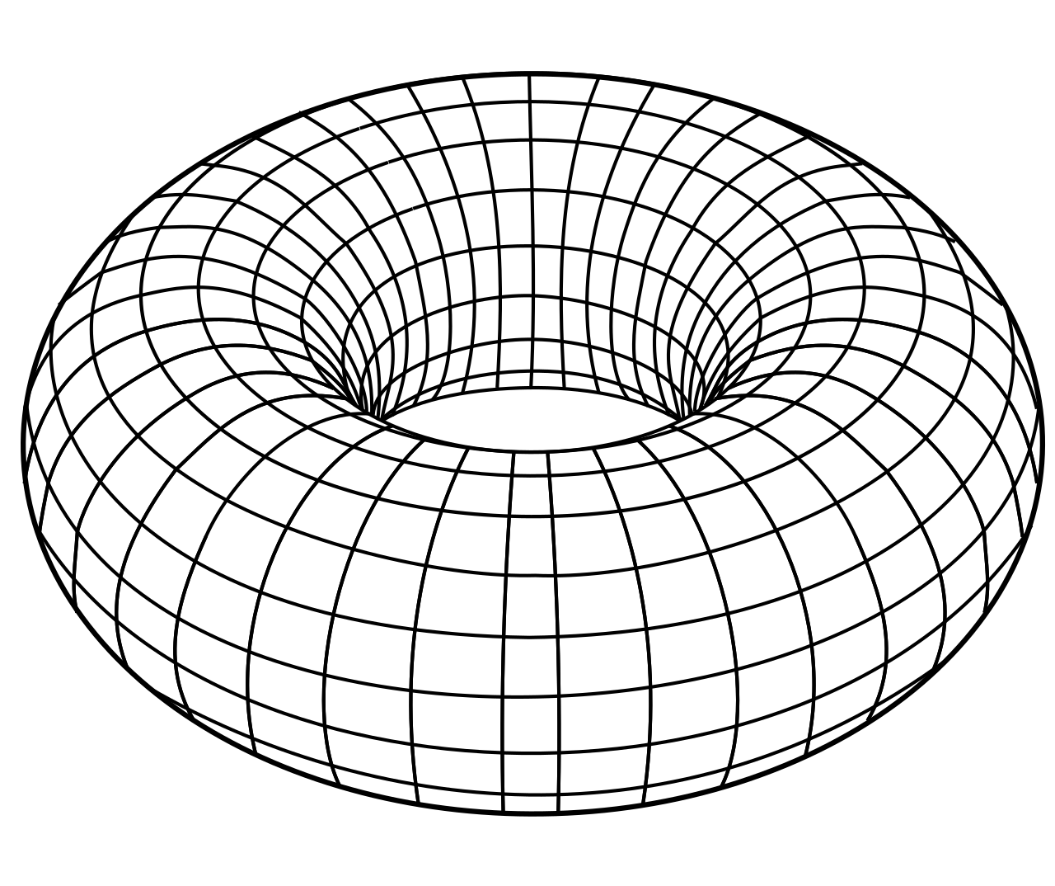
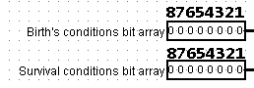
Improvements
Toroidal cycled field with size 32*32.
Expended simulation rules. Now we can set different birth or survival conditions.
Inputs for expended simulation rules

Slide 5
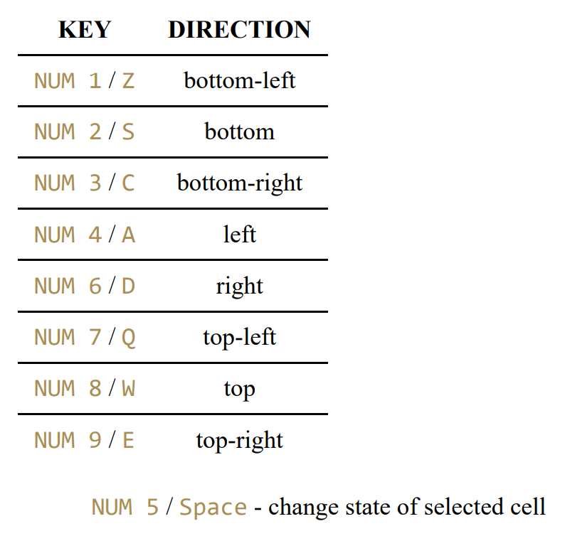
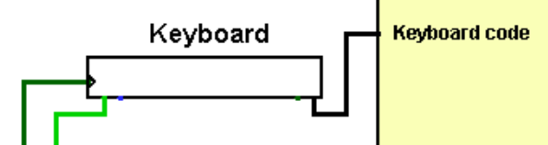
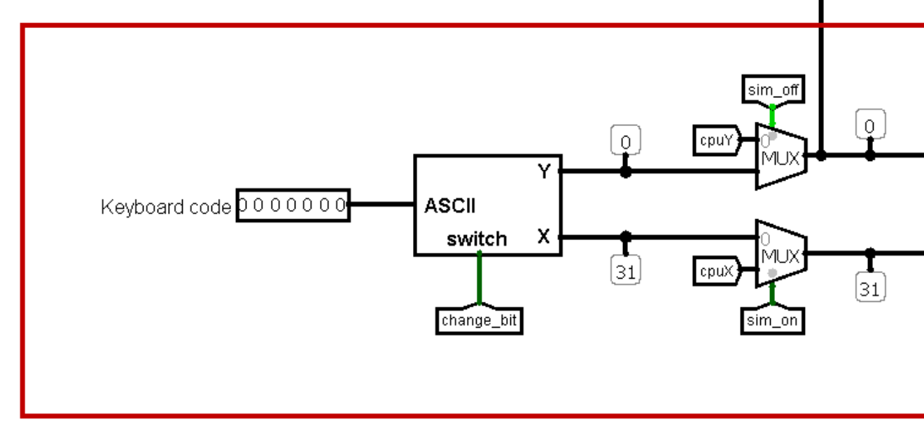
Keyboard for cursor’s moving
Keyboard controller
Keyboard layouts

Slide 6
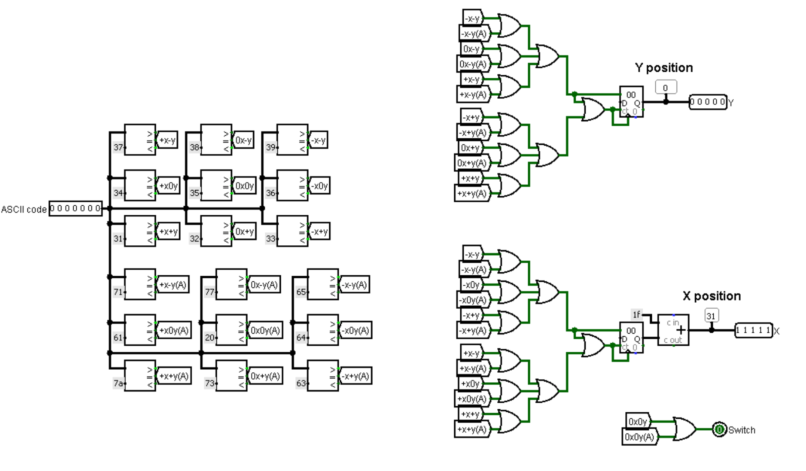
Keyboard controller (inside)

Slide 7
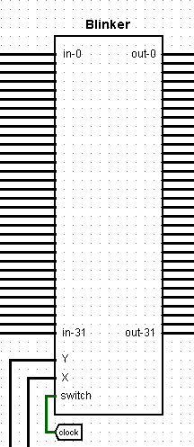
Blinker
Blinker is used to track processed cell.
Blinker quickly switch cell color and makes it easy to recognise.

Slide 8
Difficulties and solutions

Slide 9
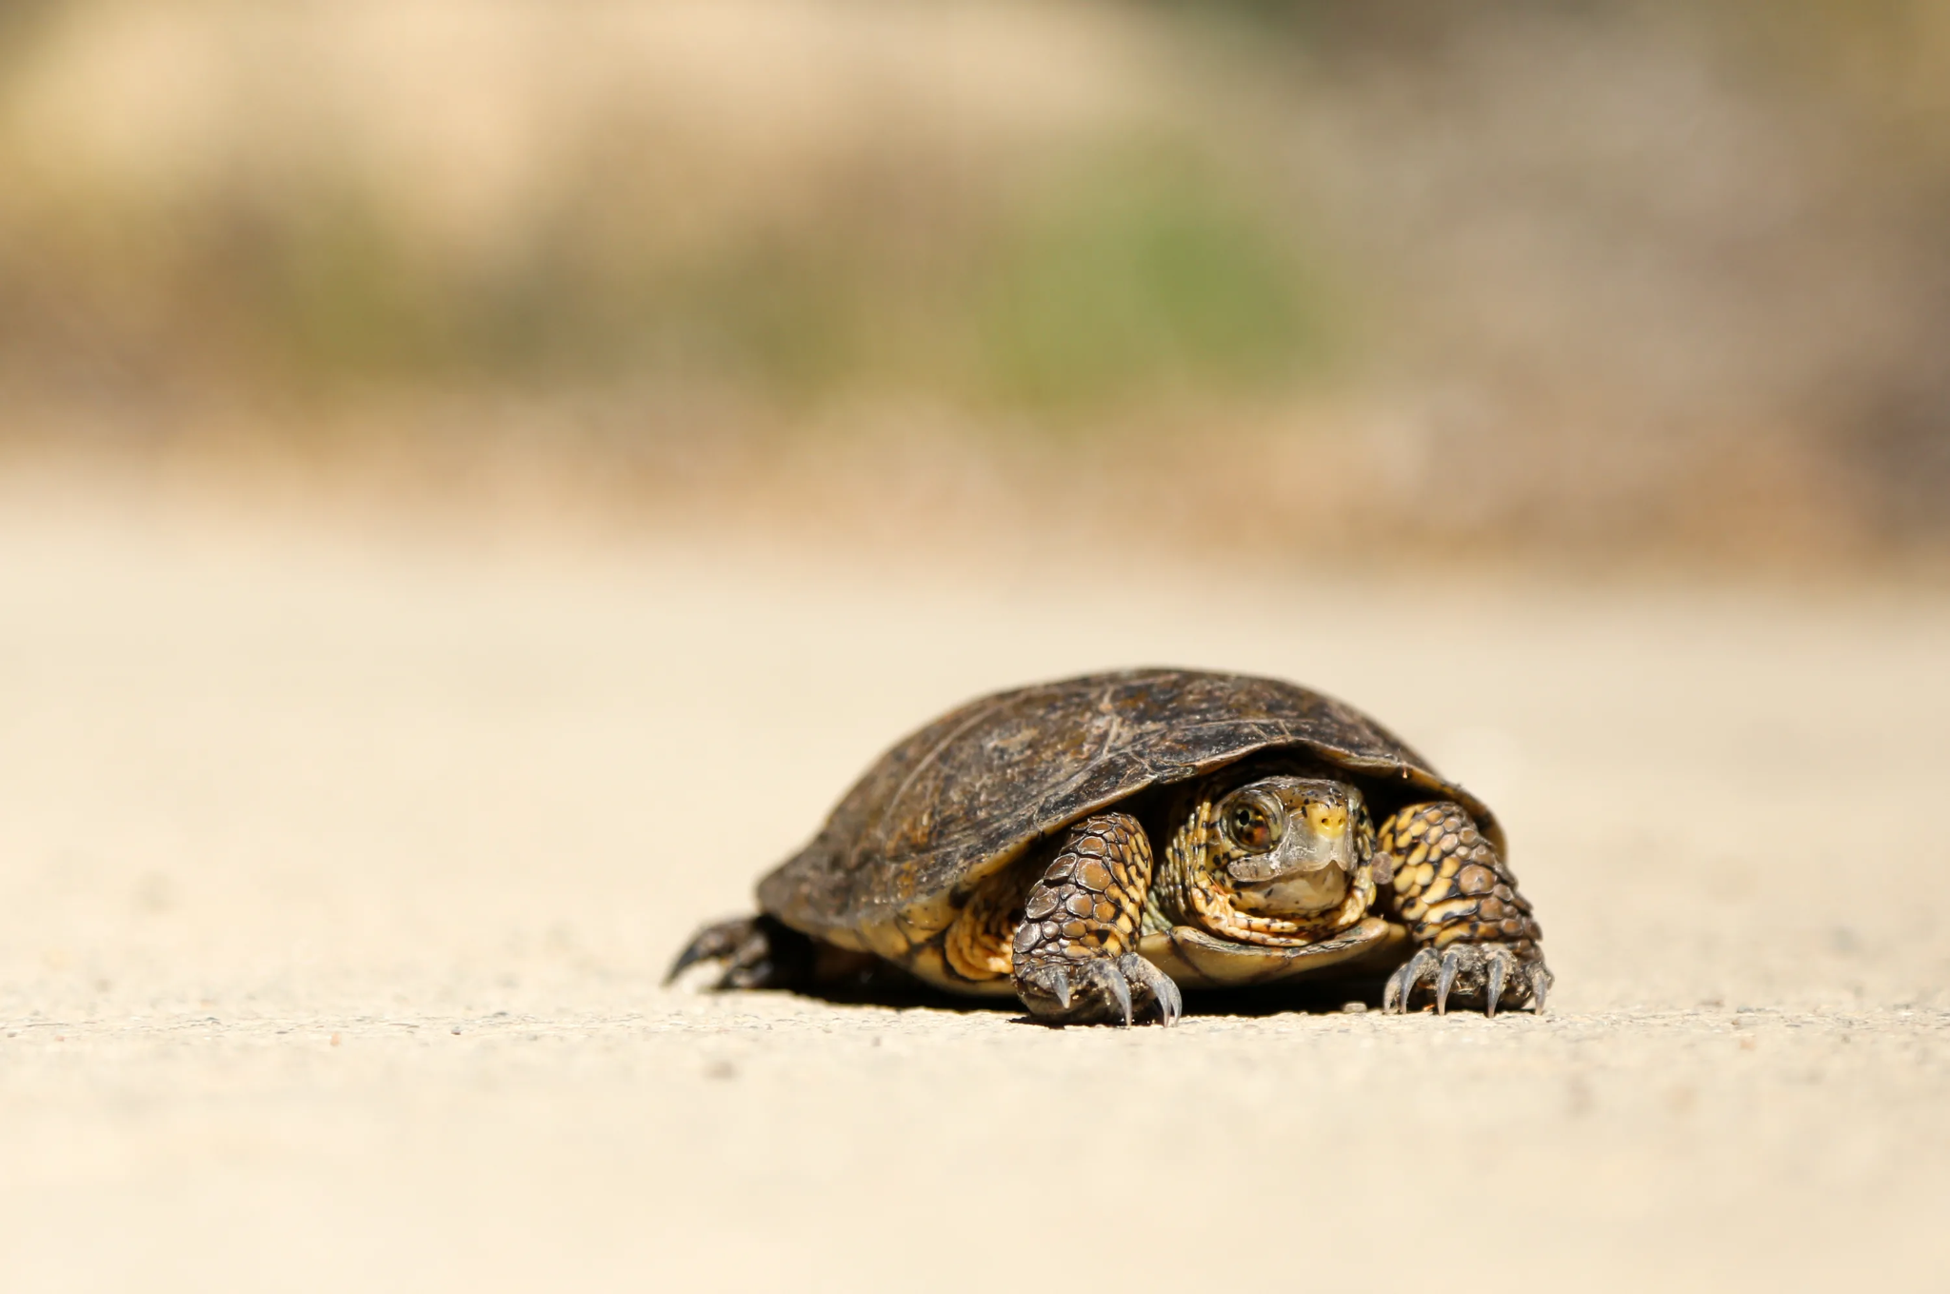
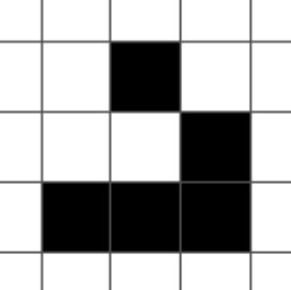
Optimization
On Ryzen 5 5600H the first version counts frame for simple Glider 30-60 minutes!

Slide 10
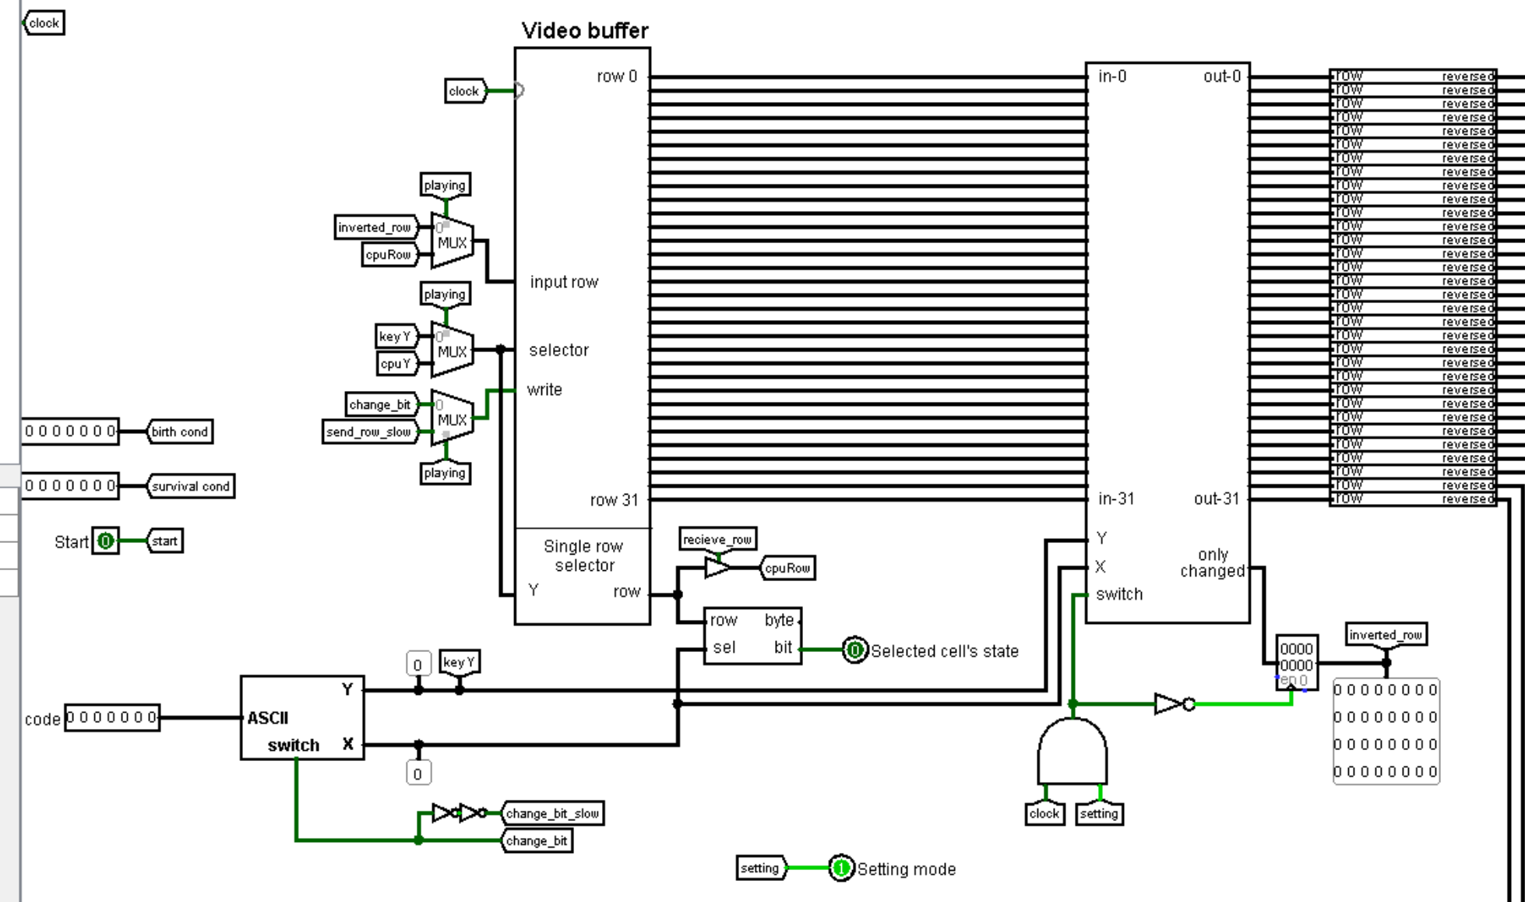
Logisim jobs (Old)
Main circuit’s part

Slide 11
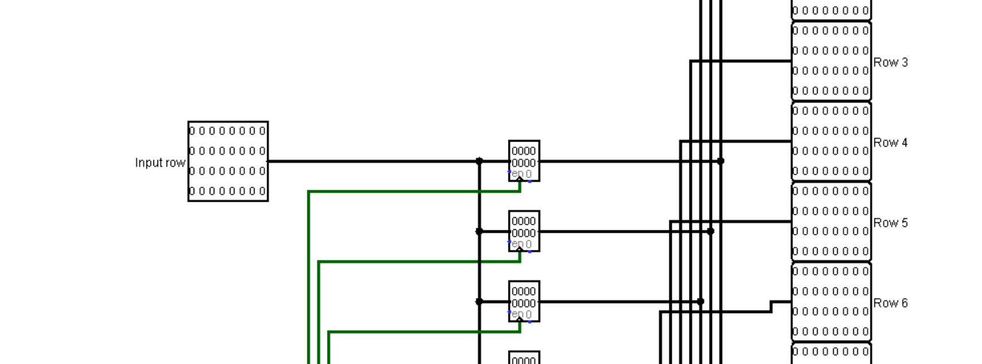
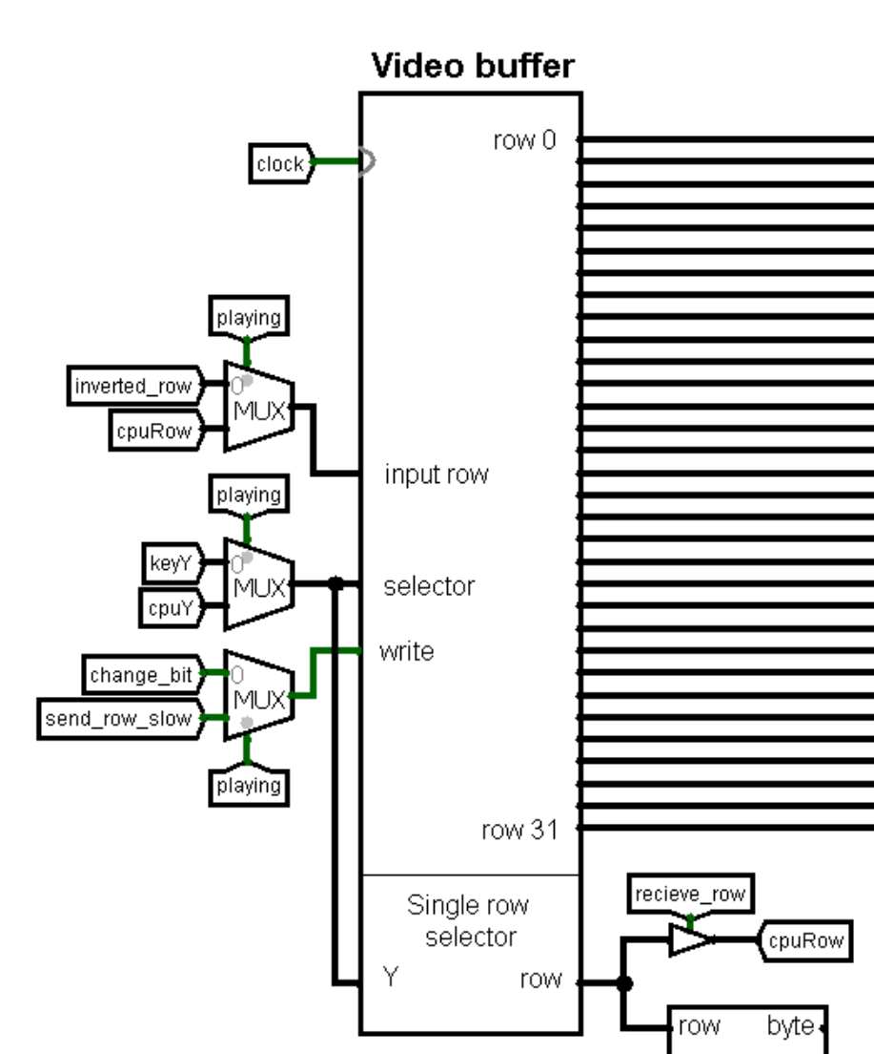
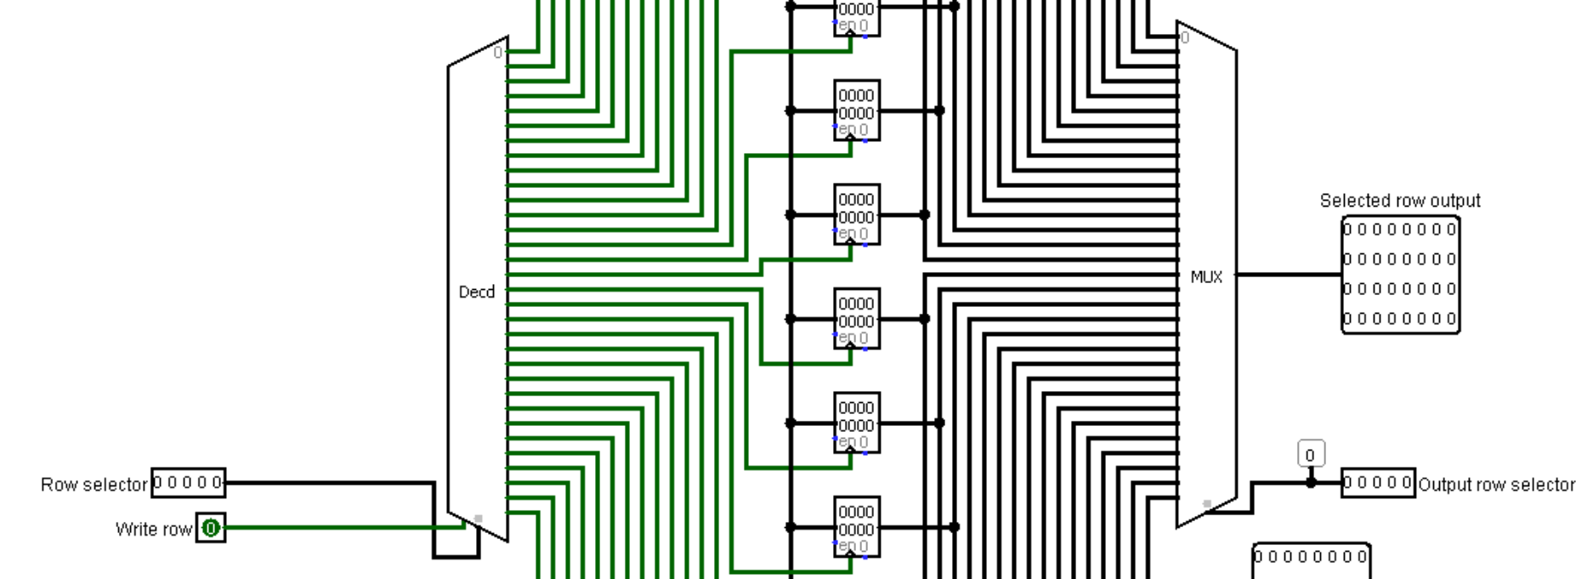
Random access buffer (inside)

Slide 12
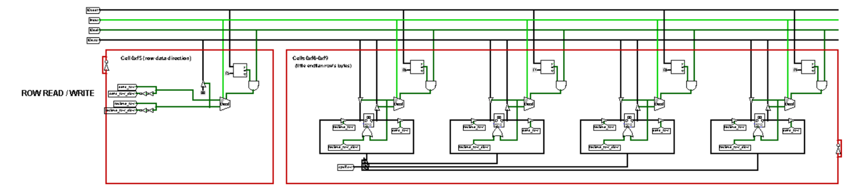
I/O registers for row
Read signal to the first pseudo register => load 32-bit from buffer and split into the 4 next registers
Write signal to the first pseudo register => join bytes from registers and write row to the buffer
Interface for read/write interaction with CPU

Slide 13
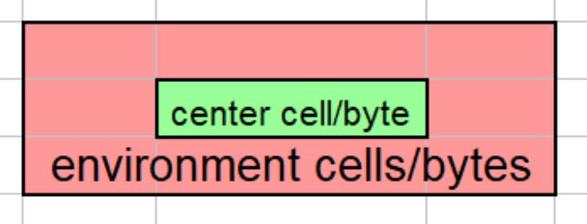
CPU jobs
Processing of every cell using environment constructing in-place and bit shifts was too long. ~ 2^16
We used CdM-8e with ~400 bytes in ROM.
For frequency 4.1 KHz we got 300 Hz…
Environment concept is the same for cells (bits) and bytes

Slide 14
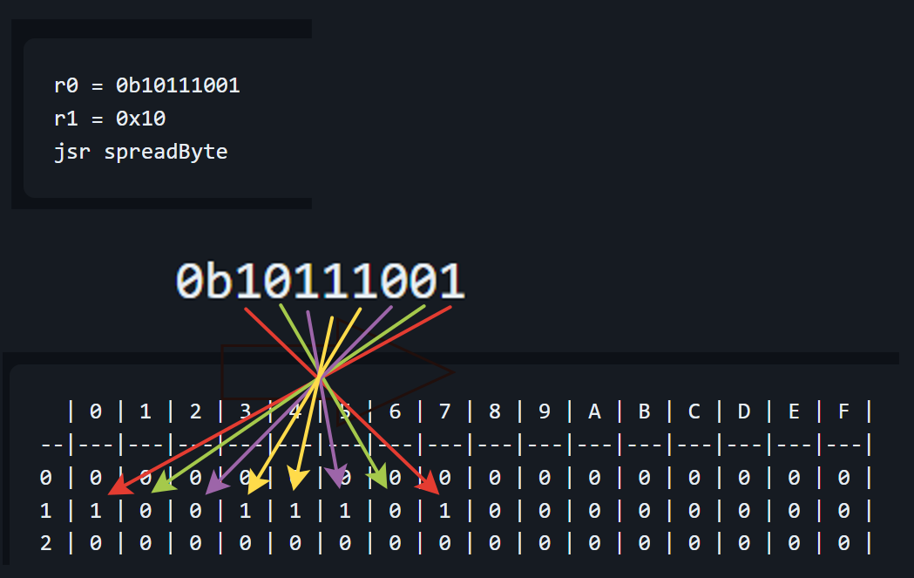
Byte spreading - The First Optimization Idea
N bit = value from cell with address beginAddr + N
Constant time for getting bit!
Good, but not enough…
Byte spreading illustration

Slide 15
Jobs redistribution - forced step
Logisim jobs
CPU jobs

Slide 16
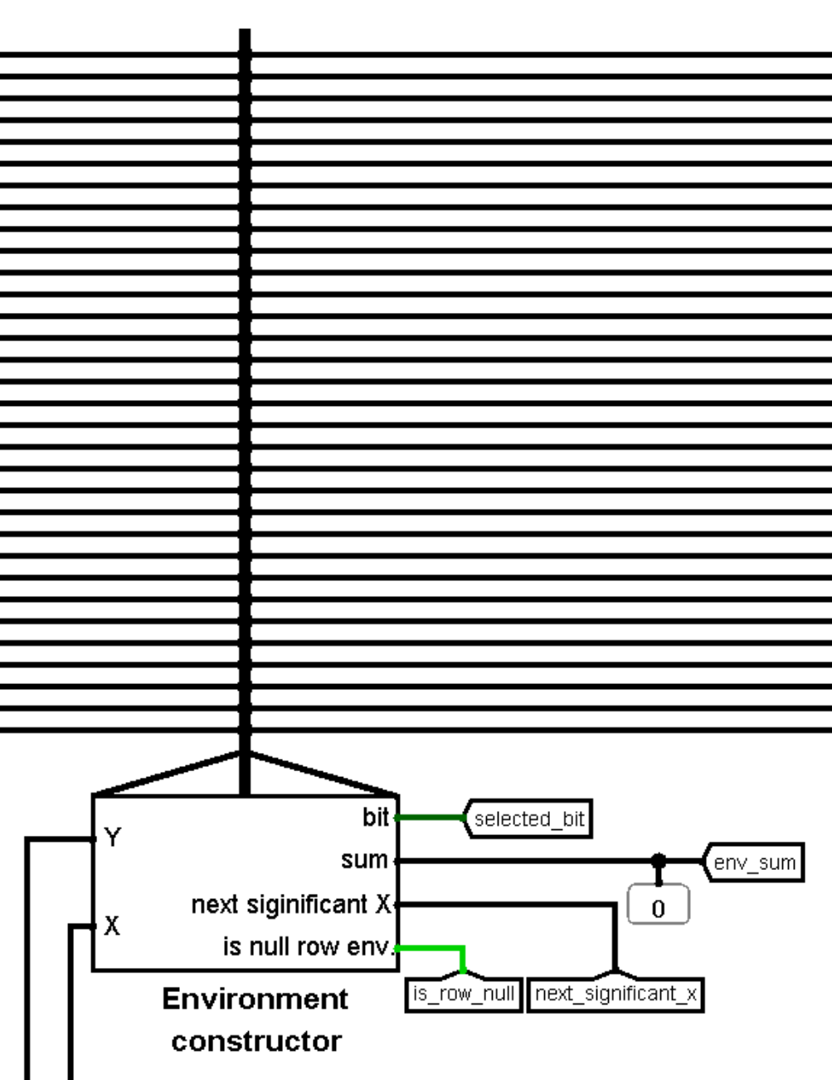
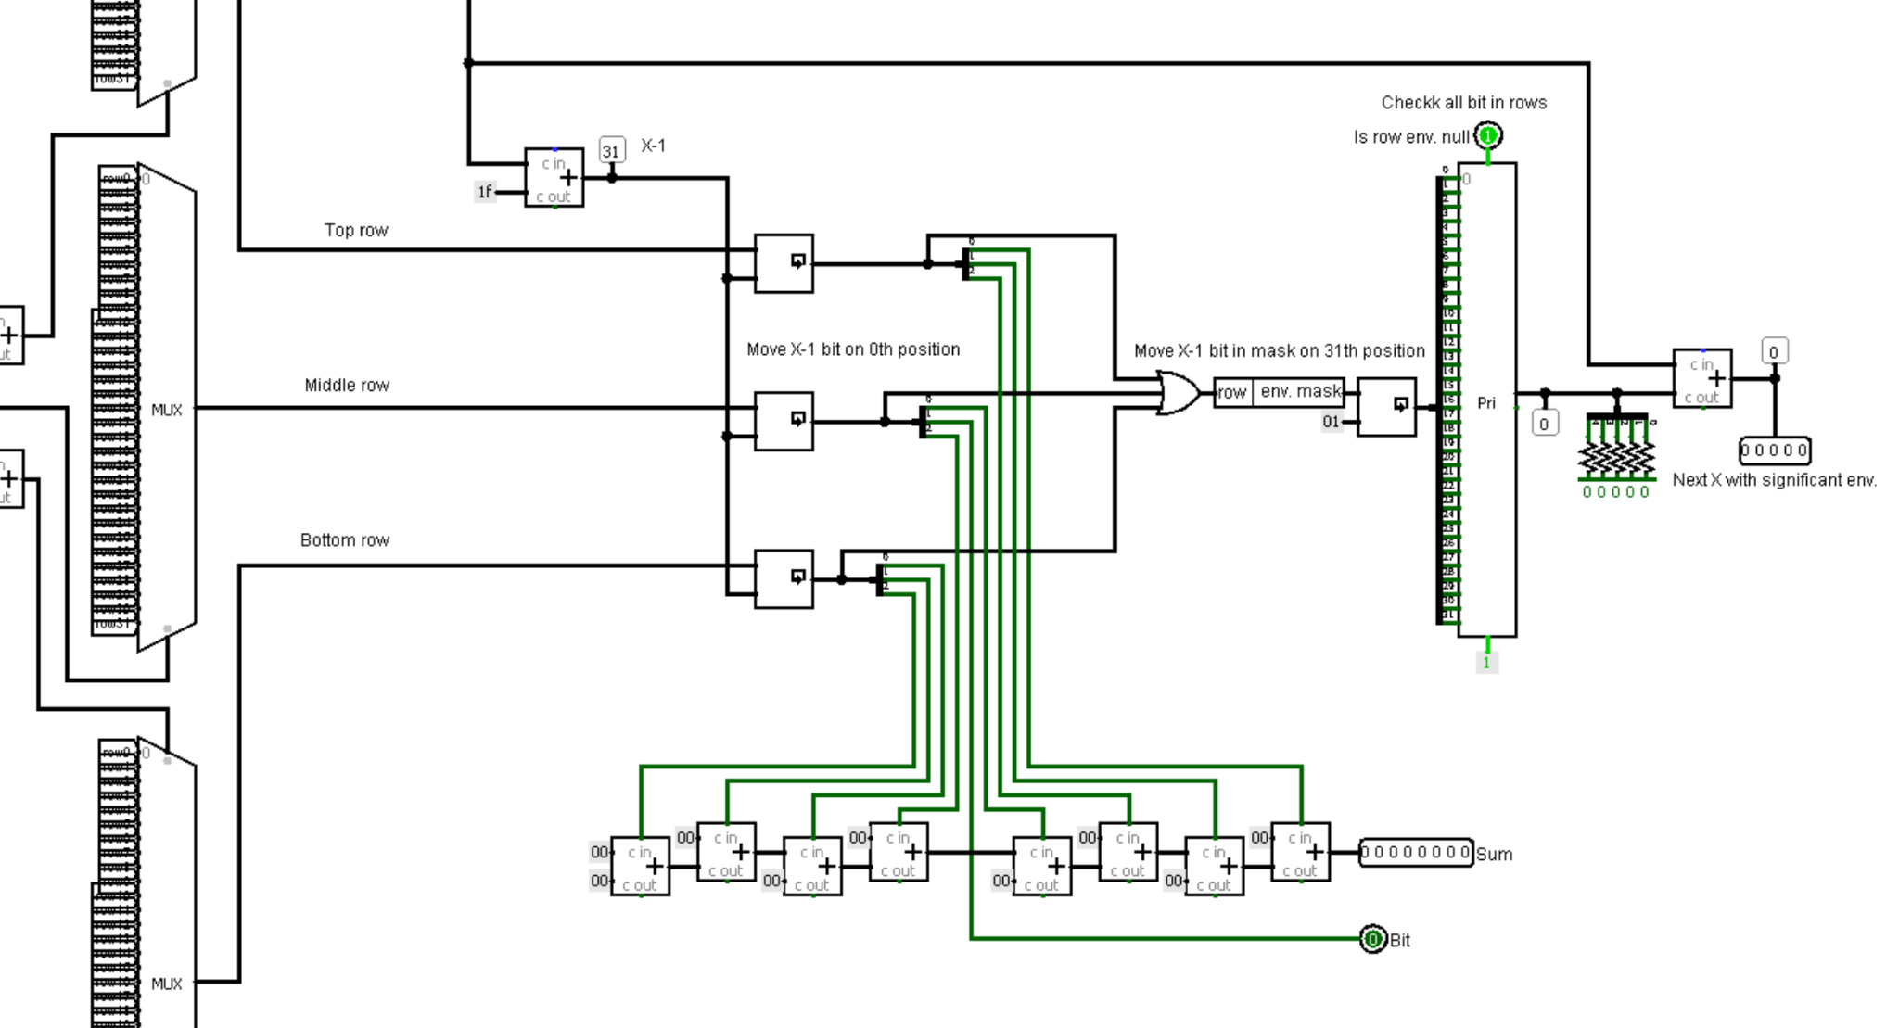
Environment data constructor

Slide 17
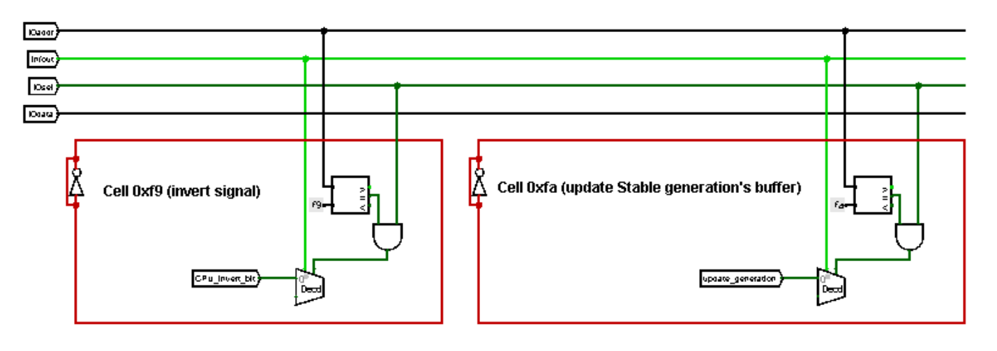
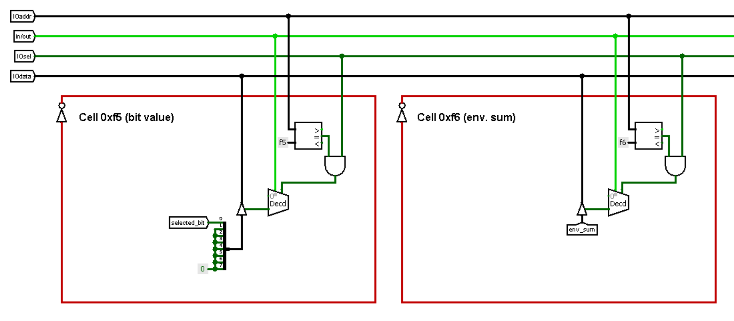
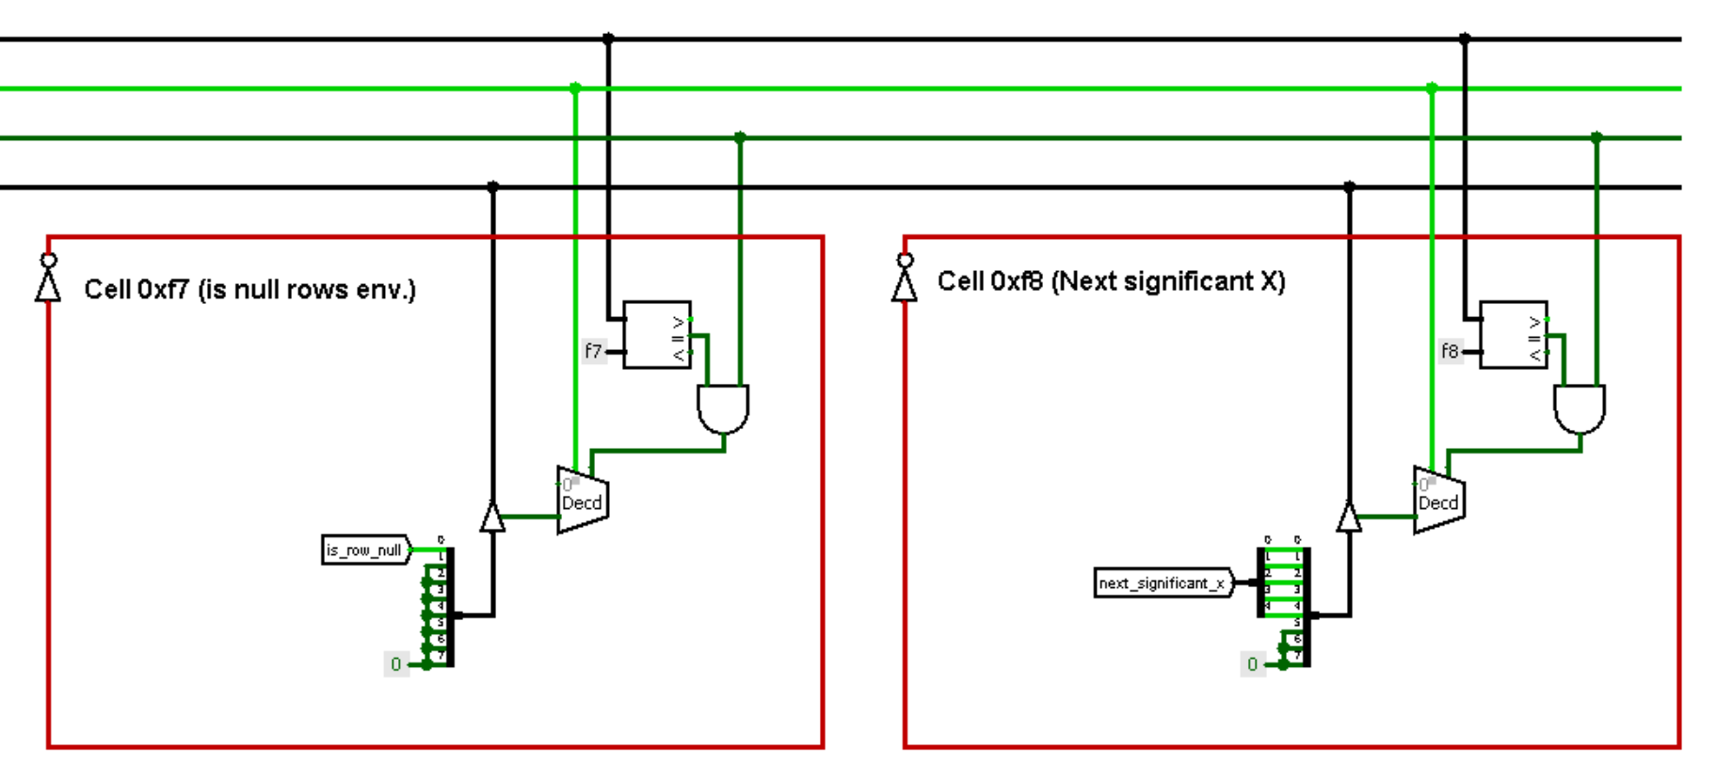
Changes in I/O registers
New registers is much simpler!

Slide 18
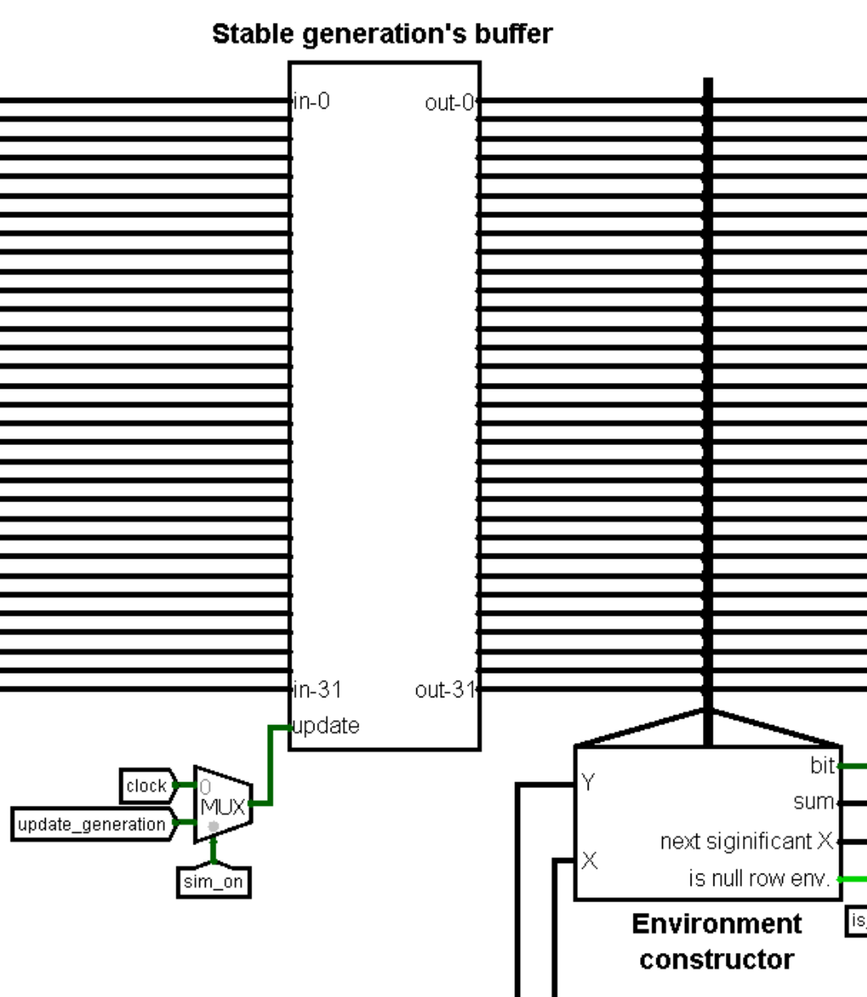
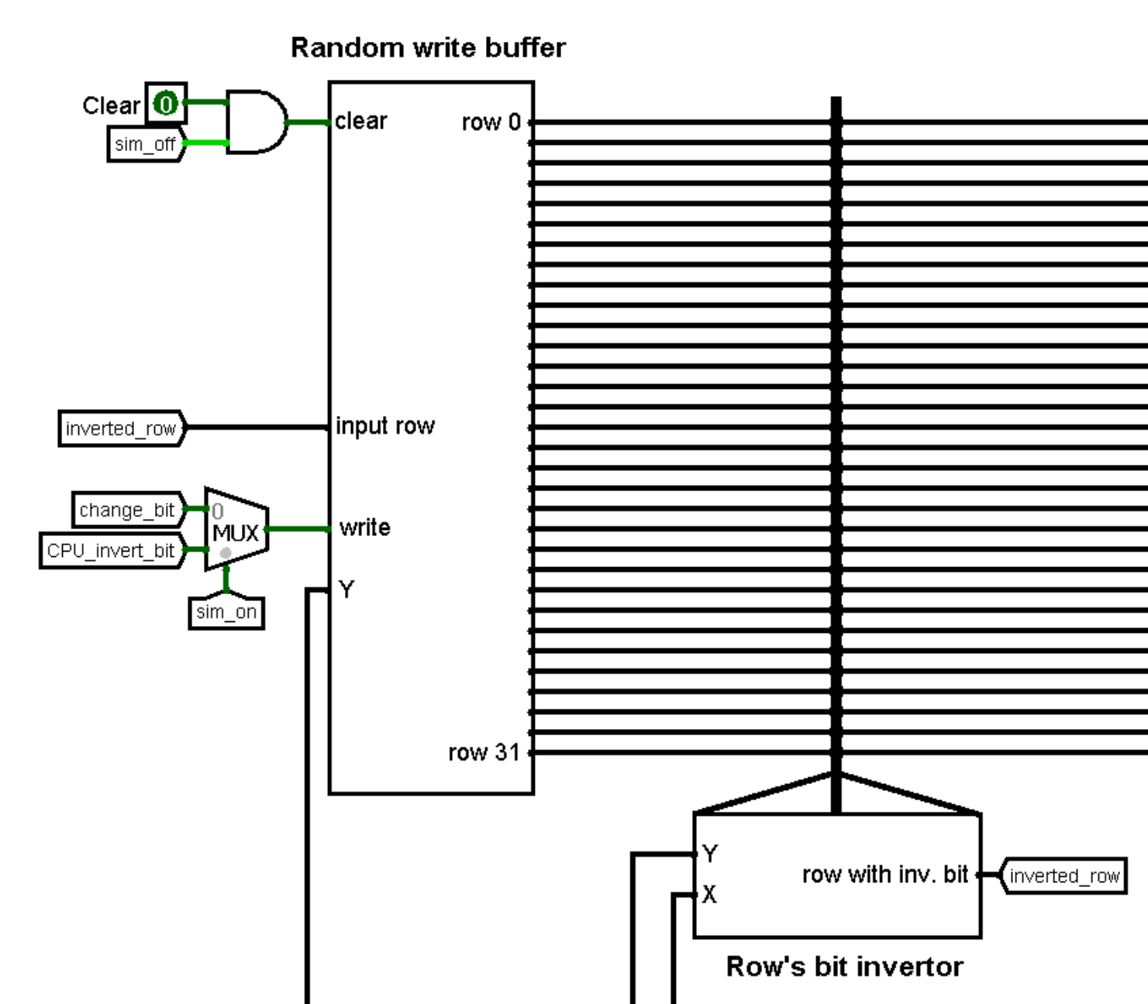
Random access buffer’s splitting

Slide 19
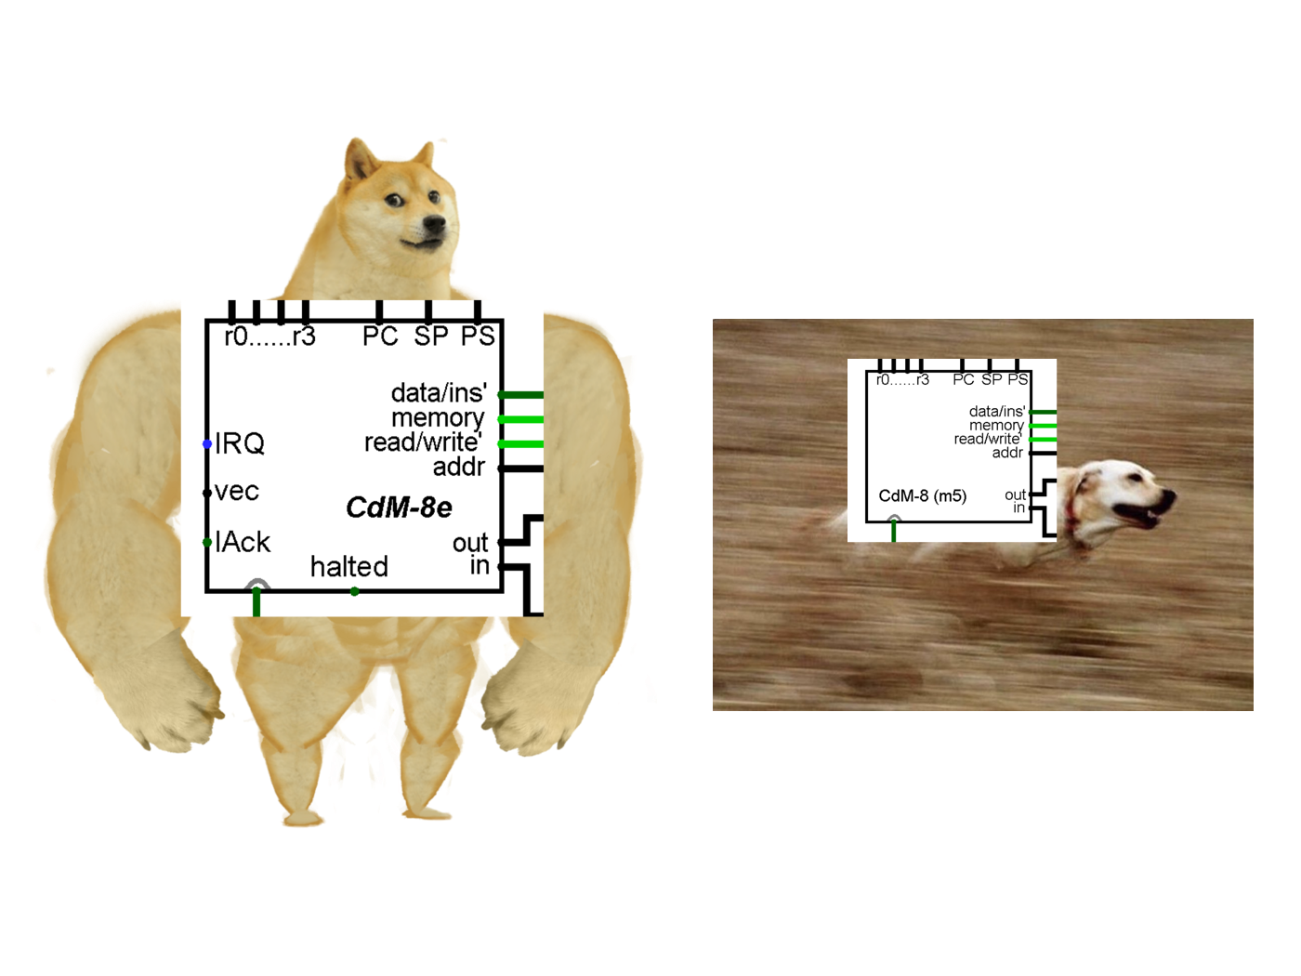
CPU changes
Main cycle process only significant environments and don’t construct full rows in RAM
We migrated back to the CdM-8 with ~130 bytes in ROM.
For frequency 4.1 KHz we got 600 Hz!
Sometimes simpler means better!

Slide 20
Win!
For Glider 1 frame is counted for
~8 seconds.
For ALL field frame is counted for ~200 seconds (fortunately, it’s such rare case)

Slide 21
Demonstration

Slide 22
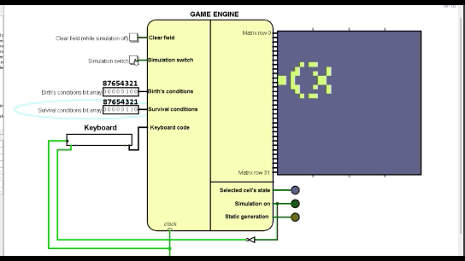

Copperhead: B 23 / S 3
Animation
Video link
https://youtu.be/S__gxg4_Kj0

Slide 23
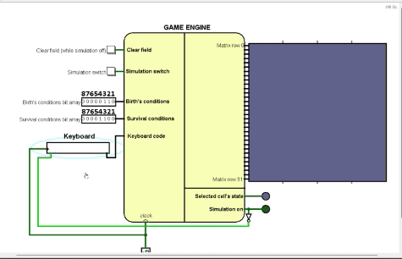


Virus: B 23 / S 34
Animation
Video link
https://youtu.be/TYsqerYqUMo

Slide 24
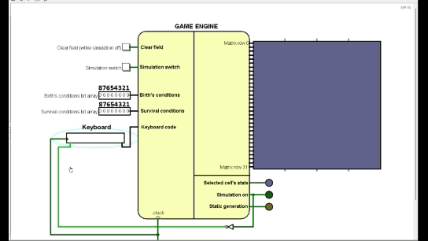

Fractal: B 1 / S 12345678
Animation
Video link
https://youtu.be/PsEWbzamm94

Slide 25




Choose your fighter!
Glider
Toad
Angel
Arrow

Slide 26


